Slide 1

Introducing Nonacat
Guerilla Hacking an Extra Arm onto GitHub
Notes:
Introducing Nonacat (Guerilla Hacking an Extra Arm onto GitHub)
GitHub, as instrumental as it is, knows that they cannot possibly offer a one-size-fits-all service that meets the needs to every OSS project. With that in mind, come join Nik Molnar, co-founder of Glimpse, for a session on how to extend GitHub by leveraging their API’s, cutting edge web technologies and free/open source tools to provide users, contributors and project maintainers with a better overall experience.
This session is not about Git itself and is suitable for OSS project maintainers and all users of GitHub.
What is a Nonacat?

Slide 2

Introduction
nik molnar
→ nikmd23@gmail.com
 nikmd23
 nikmd23
Notes:
I am Nik Molnar – from NY, web dev of 16 years, co-founder of Glimpse, full time OSS.
This talk started as a request – lets break into a little story.

Slide 3
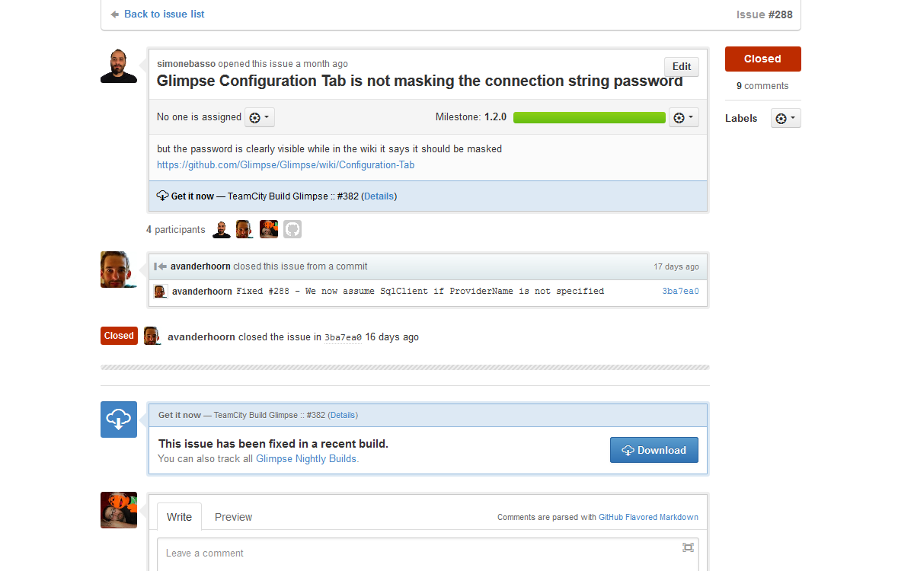
Introduction
Notes:
On glimpse we constantly fix issues, but don’t necessarily release right away. We constantly had to tell users how to get the latest “unofficial” bits.
So I put together a mock up of what I thought GitHub should do to help solve this problem, tweeted it out and hoped that one day my feature would exist.
That’s when I realized that this is the web, I don’t have to wait for some vendor to give me what I want. I can just use the natural extensibility points of the web to take matters into my own hands.

Slide 4
Introduction
feature request
Notes:
On glimpse we constantly fix issues, but don’t necessarily release right away. We constantly had to tell users how to get the latest “unofficial” bits.
So I put together a mock up of what I thought GitHub should do to help solve this problem, tweeted it out and hoped that one day my feature would exist.
That’s when I realized that this is the web, I don’t have to wait for some vendor to give me what I want. I can just use the natural extensibility points of the web to take matters into my own hands.

Slide 5
GitHub
Notes:
Before we get too far down the road to adding in the ninth arm, we should first make sure we are utilizing the ones we already have.
GitHub does a lot, and has lots of neat kind-of-hidden-features. One of my favorites is their extended markdown support.

Slide 6

GitHub
markdown
 commonmark.org
Notes:
Cover what markdown is?

Slide 7
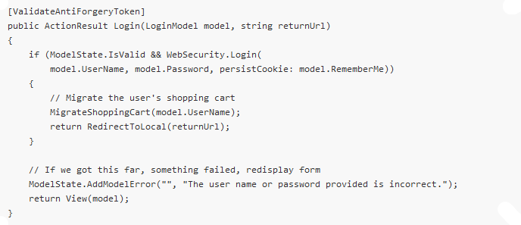
GitHub
```
Notes:
Syntax highlighting via backticks

Slide 8
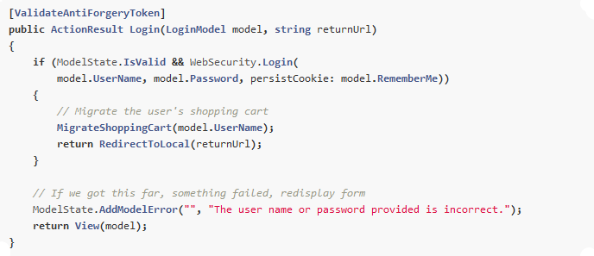
GitHub
```
```csharp
Notes:
[DEMO] Markdown Pad Pro that shows off many features of GitHub flavored markdown

Slide 9

GitHub
emoji
 emoji-cheat-sheet.com
Notes:
Emoji, with sample from Emoji Dick, and emoji-cheat-sheet.com
[DEMO] Special placement of Readme.md and Contributing.md
[DEMO] Markdown Pad Pro

Slide 10

GitHub
Notes:
People get really into Emoji with sample from Emoji Dick – show book, and emoji-cheat-sheet.com
I want to paste Emoji Dick into someone’s issue one day
Also GitHub has great little usability tricks
[DEMO] Keystrokes:
G I – issues
G P – pull requests
G C – code
T – find file
L – jump to line
G I – back to issues
J and K – navigate issues
R – Reply to issue, select some text

Slide 11

GitHub
Notes:
People get really into Emoji with sample from Emoji Dick – show book, and emoji-cheat-sheet.com
I want to paste Emoji Dick into someone’s issue one day
Also GitHub has great little usability tricks
[DEMO] Keystrokes:
G I – issues
G P – pull requests
G C – code
T – find file
L – jump to line
G I – back to issues
J and K – navigate issues
R – Reply to issue, select some text

Slide 12
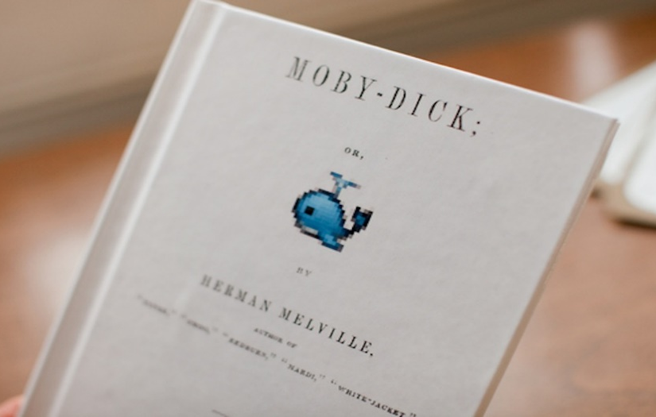
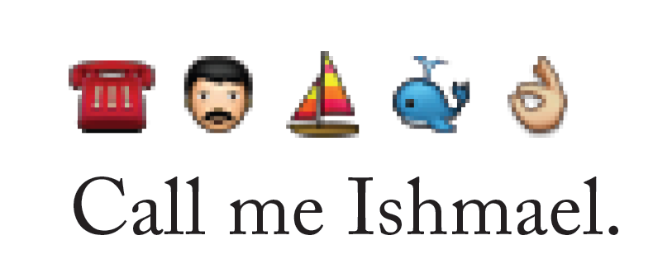
GitHub
Notes:
People get really into Emoji with sample from Emoji Dick – show book, and emoji-cheat-sheet.com
I want to paste Emoji Dick into someone’s issue one day
Also GitHub has great little usability tricks
[DEMO] Keystrokes:
G I – issues
G P – pull requests
G C – code
T – find file
L – jump to line
G I – back to issues
J and K – navigate issues
R – Reply to issue, select some text

Slide 13
Conventions

Slide 14

Conventions
file name
 5minfork.com
 remy/5minutefork
Notes:
File names:
Static index.html enables Remy Sharp’s 5minfork.com site to temporarily host the source. https://github.com/nikmd23/oss0to60

Slide 15
Conventions

uri
 gitprint.com
Notes:
URI:
Change the URI on any markdown file from GitHub.com to GitPrint.com to convert the MD file to PDF
Example: https://gitprint.com/jquery/jquery/

Slide 16

Conventions
issue tags
 huboard.com
 rauhryan/huboard
Notes:
Issue Tags:
[DEMO] Huboard.com - http://huboard.com/nikmd23/scratchPad/board

Slide 17

Conventions
gists
 jsfiddle.net
Notes:
[DEMO] Gists – jsFiddle demo - http://doc.jsfiddle.net/use/gist_read.html http://jsfiddle.net/3HJF4/

Slide 18
Standards

Slide 19

Standards
open search
 opensearch.org
Notes:
Search:
@nikmd23

Slide 20

Standards
syndication
 atompub.org
 twitterfeed.com
Notes:
RSS to IFTTT

Slide 21
Extensions
Notes:
Intro extensions – not really open/kinda proprietary.
UserScripts are a bit more portable and easier to develop.
voterScript – no need to show the token hider.

Slide 22

Extensions
browser extensions
 buunguyen/octotree
 sanemat/do-not-merge-wip-for-github
Notes:
Demo at https://github.com/Glimpse/Glimpse/tree/master/source/Glimpse.Core/Framework

Slide 23

Extensions
user scripts
 greasyfork.org
 nikmd23/voterScript
Notes:
Intro extensions – not really open/kinda proprietary.
UserScripts are a bit more portable and easier to develop.
voterScript – no need to show the token hider.

Slide 24
WebHooks
Notes:
Intro webhooks
Show github services – DEMO HipChat, Revision.io
Demo ngrok for testing
Show sample webhook code

Slide 25

WebHooks
web hooks
 webhooks.org
Notes:
Intro webhooks
Show github services – DEMO HipChat, Revision.io
Demo ngrok for testing
Show sample webhook code

Slide 26
API
Notes:
DEMO: Show off octoKit?
Cover tokens & basic concept
WorldDomination
Things to know about GitHub API
Rate limit
Link headers

Slide 27

API
oauth
 oauth.net
Notes:
Cover tokens & basic concept
WorldDomination
Things to know about GitHub API
Rate limit
Link headers

Slide 28

API
octokit
 github.com
 octokit/octokit.net
Notes:
DEMO the OctokitDemo

Slide 29
Bonus!
Notes:
http://www.asciiflow.com/ -> https://github.com/Glimpse/Semantic-Release-Notes/issues/1

Slide 30
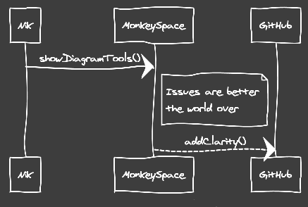
Bonus!
Notes:
http://www.asciiflow.com/ -> https://github.com/Glimpse/Semantic-Release-Notes/issues/1
Memofon -> Issue about the class hierarchy
WebSequenceDiagrams

Slide 31

Thanx!
nik molnar
→ nikmd23@gmail.com
 nikmd23
 nikmd23

